Slide 1
Bringing dignity and expanding life opportunities in rural Uganda

Slide 2
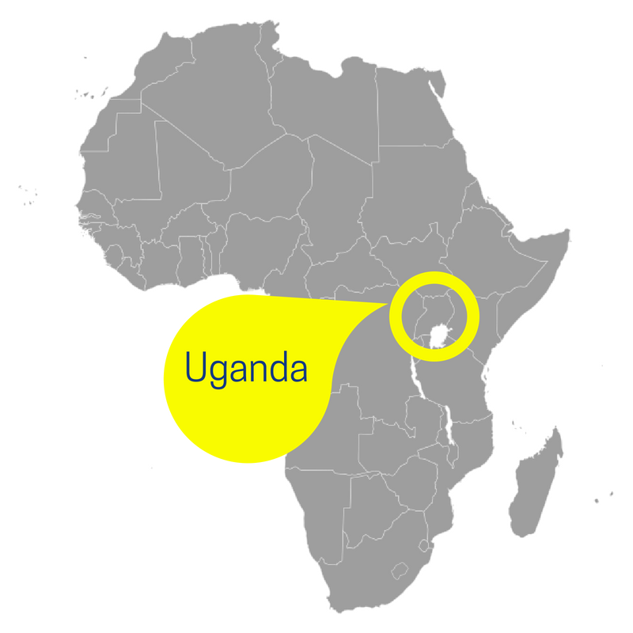
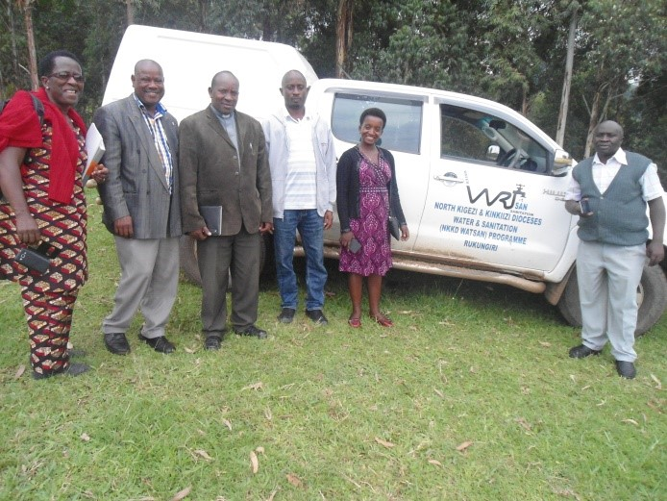
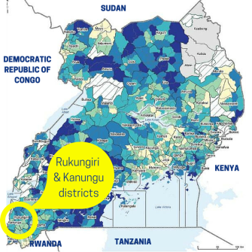
What is WATSAN?
Notes:
WATSAN consists of a small Ugandan-run staff team helping communities in Rukungiri and Kanungu Districts in the South-West of the country. The team implements simple, long-term projects encompassing the provision of clean water, dignified sanitation and hygiene education in order to improve the life chances of individuals, families and whole communities. These projects bring wellbeing and economic prosperity to some of the most deprived and isolated parts of Uganda.
WATSAN is also the registered UK charity that supports them financially. This is run entirely by a volunteer trustee board.

Slide 3
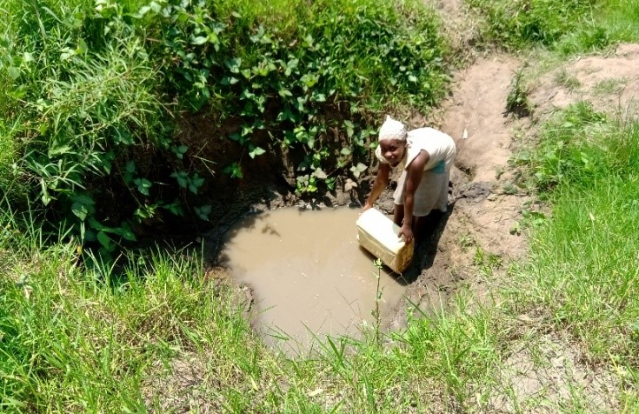
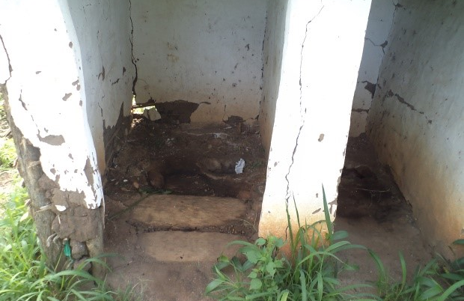
The problem
Notes:
In Uganda today many thousands of people collect their water from muddy holes, and often have to walk several kilometres to collect it. Women and children bear the brunt of this work. In wetter areas the water is often low down and they must return up muddy slopes carrying 20 kg on their heads.
Toilets are squalid, fly-blown and dangerous, and often not used – people prefer to go in the wild, polluting the unprotected water sources even further.
The big problem is all about the knock-on effect of poor access to water and sanitation: people regularly get sick. Children miss on average 25% of their education whilst suffering from water-borne illnesses, and also because they are collecting water for their families. For the girls it’s even worse – they miss school whilst they are menstruating, as there are no washing facilities at school.
This in turn means that there is a lack of social mobility, with poverty becoming embedded and reproducing itself again and again across generations.
And we shouldn’t forget the point about dignity: how would this make you feel?

Slide 4
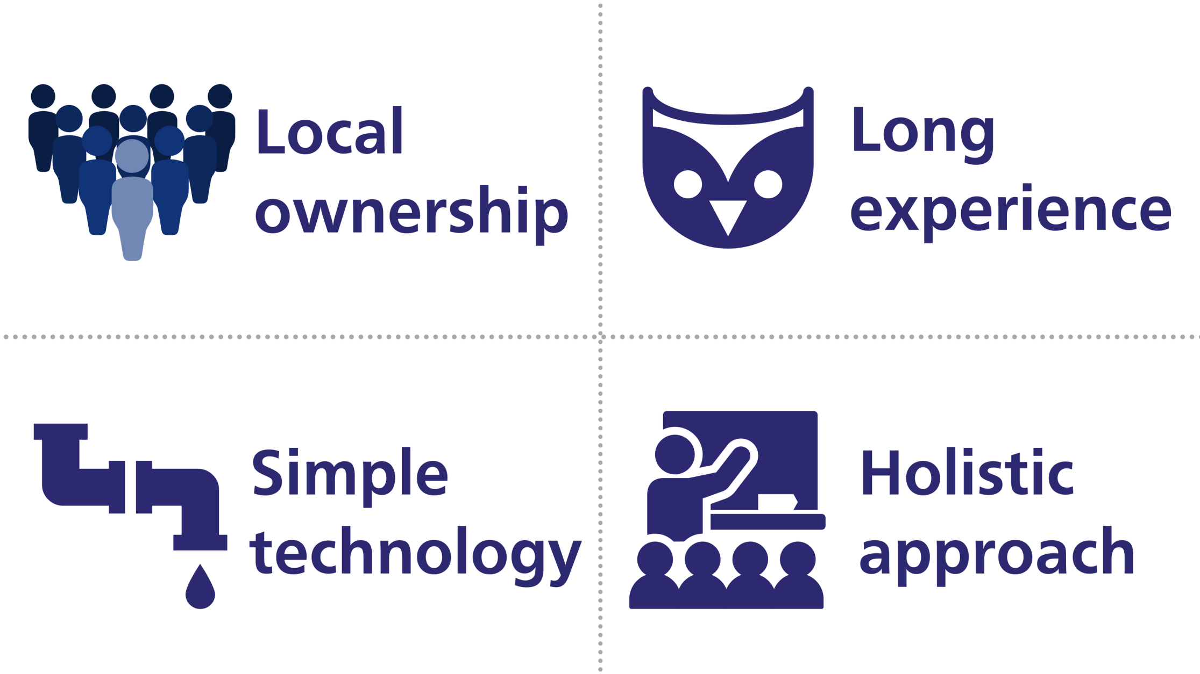
WATSAN’s ethos
Notes:
Every WATSAN project has these four empowering elements:
It is owned by the local community – WATSAN gets their buy-in to construction right from the start, and formally hand the project over to them at the end. This includes some of the fundraising.
WATSAN’s experienced staff have been operating in the area since the 1980s, and have built the trust of local community leaders.
The structures built are simple – Africa is littered with complex, broken down projects created by well meaning westerners; WATSAN’s are largely static and made of bricks and cement, using local aggregates collected by the communities where possible!
The approach is holistic in that WATSAN never just builds water and sanitation facilities (known as hardware) – every project also has a community engagement and hygiene education component (known as software).

Slide 5
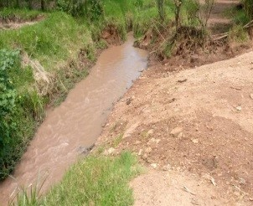
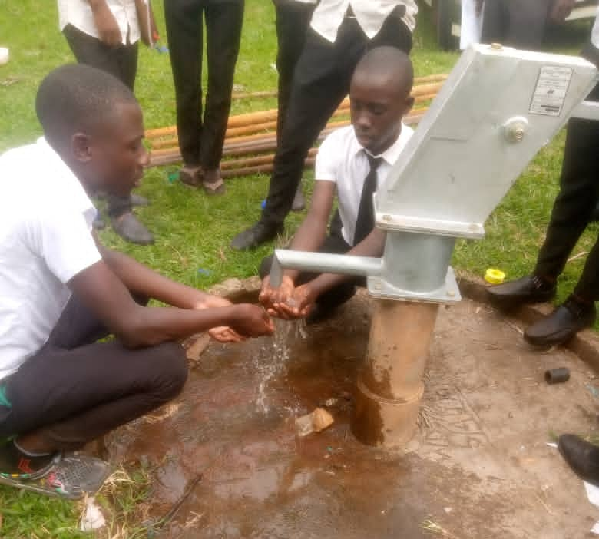
Water
BEFORE
AFTER
Notes:
How would it make you feel to have to collect water from the muddy pool on the left? This is what pupils at school in Bwanga Hill were doing before our project. In fact, they spent so much time fetching and carrying water that they missed a quarter of all their classes! It’s really hard work, the water can make you really sick, and without exams and qualifications, you have little hope of getting a good job and pulling yourself out of poverty.
WATSAN built:
Rainwater harvesting tanks x 3
Borehole (pictured)
Spring repair
Tapstands x 3

Slide 6
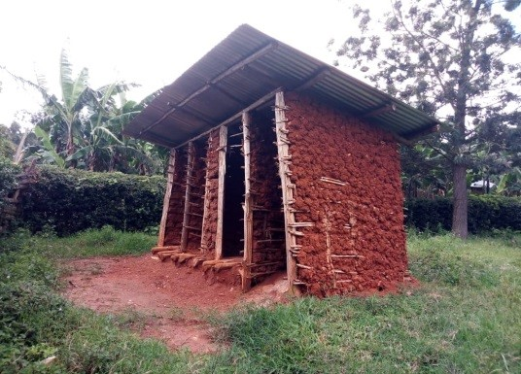
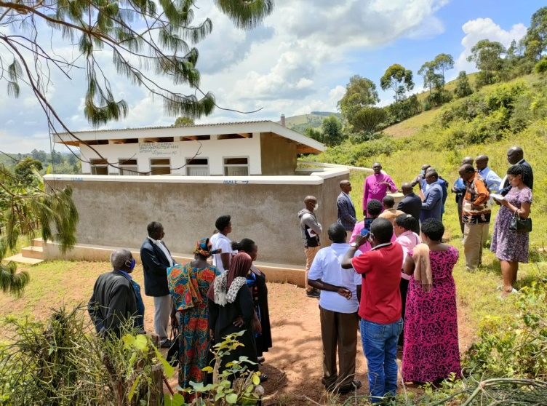
Sanitation
BEFORE
AFTER
Notes:
These are latrines that pupils at Bwanga Secondary School were using – or not. Because they were full up, squalid and full of flies (and sometimes the floors cave in), people instead go in the bushes, which pollutes the water supply and endangers health. The boys in the school were sharing one cubicle between 105 students, and the girls had one between 46 students.
Just like drinking dirty water, this makes you sick often, with diseases like diarrhoea, cholera, typhoid and dysentery, some of which kill. It is undignified and makes you feel depressed.
WATSAN built three blocks like the one on the right, with a total of 12 toilet cubicles for boys, girls and teachers at the schools.

Slide 7
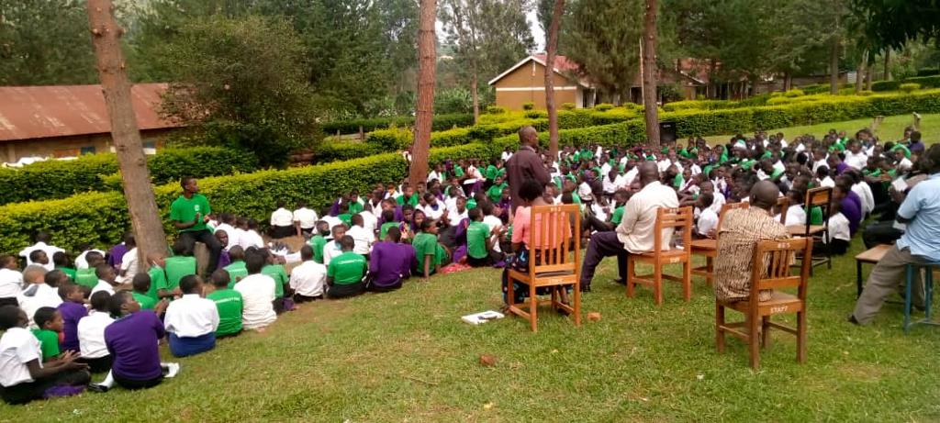
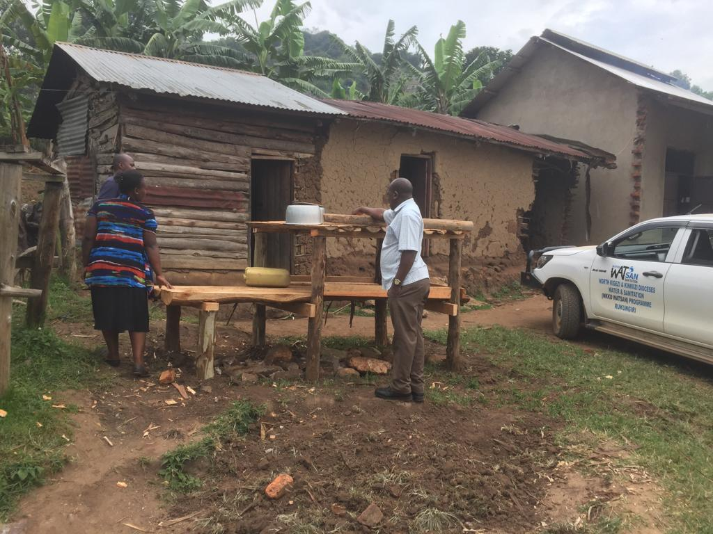
Education
Notes:
All of our projects also have education built in. Here you can see students at Bwanga secondary school learning about hand-washing and personal hygiene, which is actually just as effective as the improved facilities in reducing disease. The students from the older school also put on a play about water and sanitation to teach the younger students!
In the second picture, a family in the community is getting help building a dish-drying rack to improve hygiene at home.
Funds raised towards the projects help WATSAN pay for staff to deliver these sessions.

Slide 8
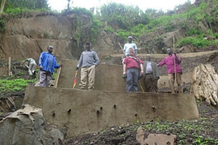
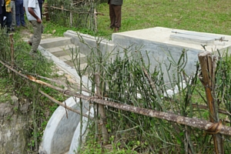
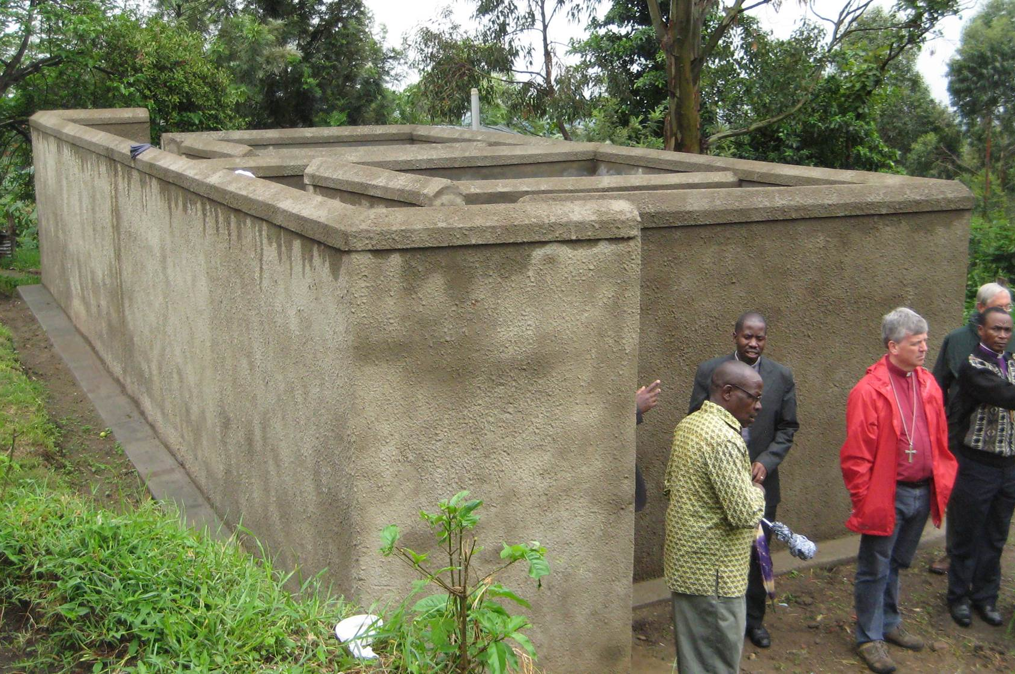
More “hardware”
Gravity flow schemes
Protected
springs
Bath
shelters
Notes:
These are some more examples of the typical ‘hardware’ WATSAN builds to collect water and provide safe sanitation.
Gravity flow water schemes take a natural water supply – usually a good strong spring protected in the hills – and use gravity to bring it to a local community. These are major schemes serving up to 5,000 or more people, schools, clinics etc.
Protected springs bring water from natural springs and directs it carefully through filtration material into a concrete structure, so that clean water can be easily collected by isolated local communities. Projects such as this involve transforming muddy, unsanitary areas surrounding springs into clean, safe water sources.
Bath shelters and clothes washing stations are additional sanitation structures often built to accompany toilet blocks.

Slide 9
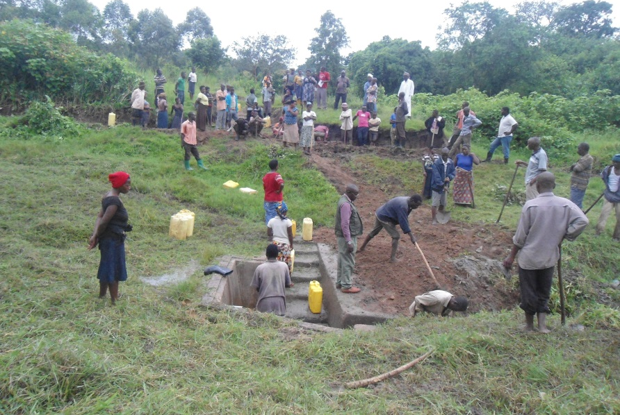
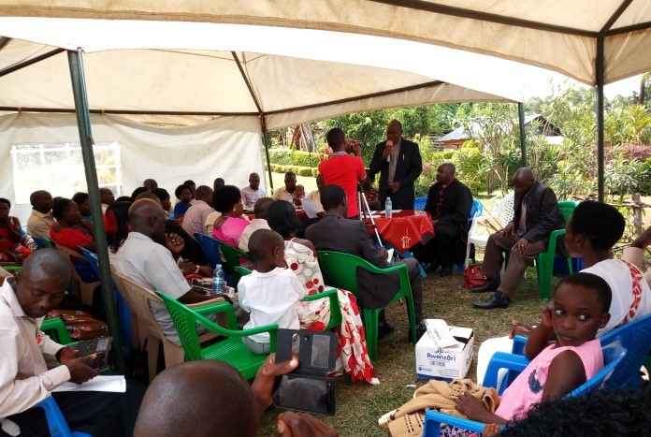
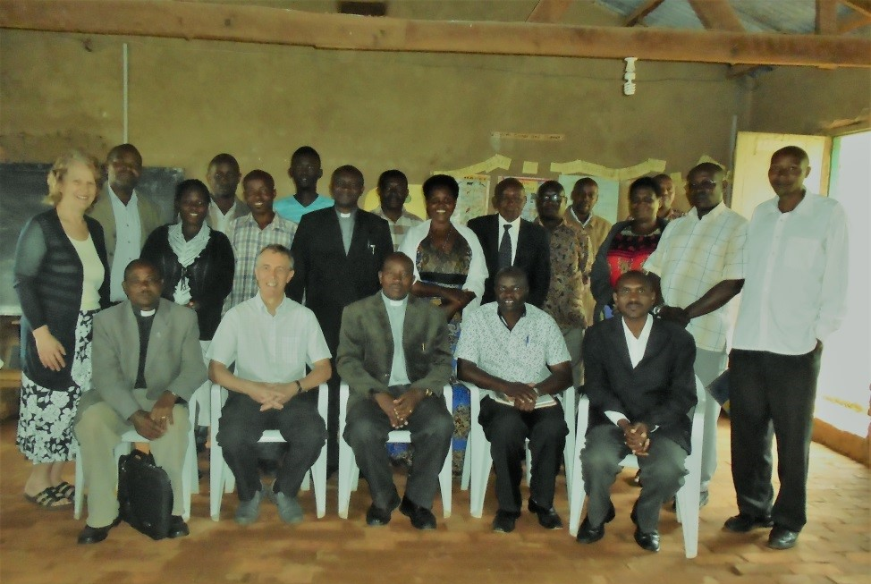
More “software”
Mobilisation
Sensitisation
Management
Notes:
Alongside overt educational interventions, these are some examples of the other community engagement or software carried out by the staff team.
The local community is mobilised to contribute physical labour and materials towards every project, and this is actually factored in to the budgeting.
The sensitisation process involves education in hand-washing, home care and personal hygiene, which is actually just as effective as the improved facilities in reducing disease.
The completed facilities are handed over to an officially formed ‘Organisation and Management Committee’. Committee members are given comprehensive training in everything from maintenance to record keeping.

Slide 10
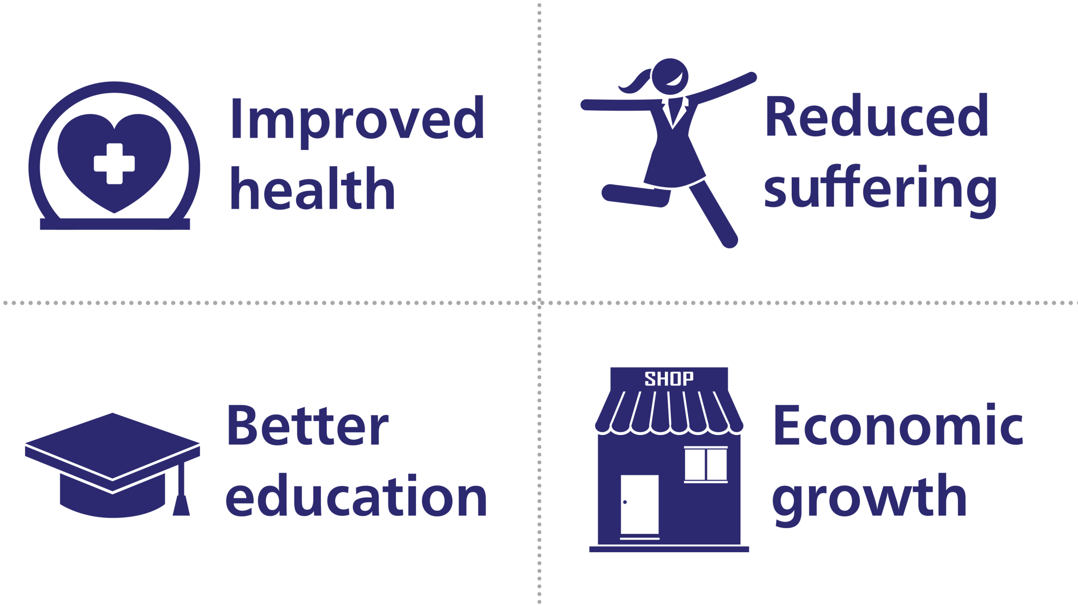
Impact
Notes:
WATSAN’s initial projects usually trigger a chain reaction of improvements. With the right support and “software”, we can be confident of these really brilliant results:
People have better health – clinics report fewer cases of diarrhoeal disease, and the water can be tested to show that there’s far less contamination by harmful bacteria
People simply suffer less – children are safer from abuse as they can be more closely supervised, and live better and longer lives
Better education is one of the most immediate and measurable impacts – school enrolments go up, better teachers are attracted to the school, and exam results improve, usually within a year of the project
This all means that communities can become more productive – WATSAN has seen that where water and sanitation are provided, women in particular have the time to maintain smallholdings or sell crafts; new facilities often spring up in the area, such as medical centres

Slide 11
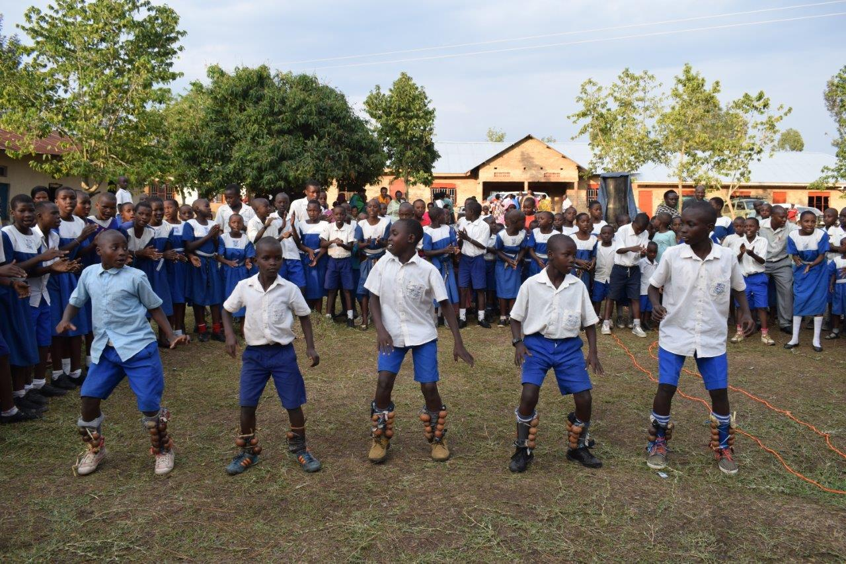
Case study
“
Previously, girls would disappear in the afternoon, but it is no longer like this. You move around and see, we have all the facilities and our pupils are smarter than before. Have you seen a village school like ours having toilet papers in the latrines?!
”
Robert Mwesigye, Senior Teacher at Ndago School, a project previously completed by WATSAN
Notes:
This quote shows how a school community can be transformed from struggling with illness and absence, to having great pride in their facilities. Yes, the pupils are smarter and better able to succeed… but they and their teachers also have DIGNITY. This is a key principal for WATSAN.

Slide 12
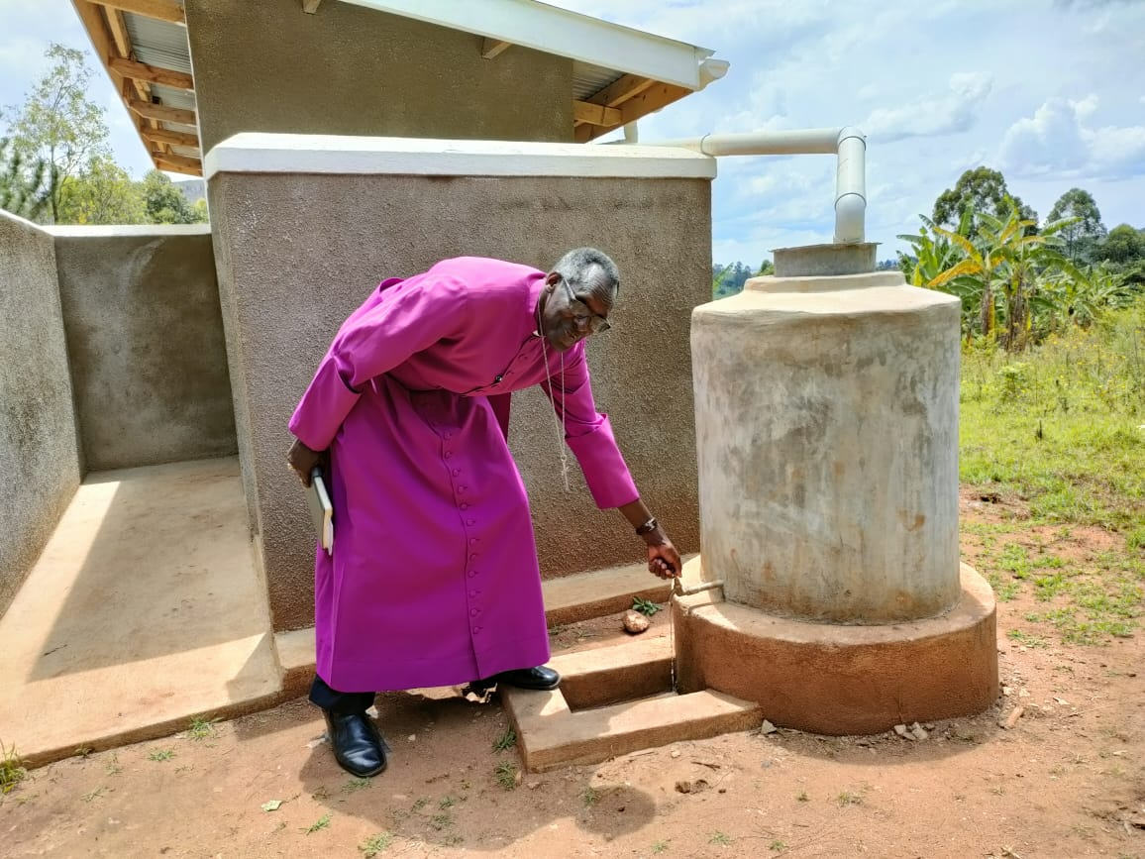
Case study
“
Thanks to WATSAN for considering Bwanga Hill area to have this project. Since the rain water in the tanks is accessible, students will have ample time to study and get good grades. It is good work done and the school has a new face.
”
Mathis Rwabugumi, Bwanga Area Councillor, about a project previously completed by WATSAN
Notes:
This quote shows how a school community can be transformed from struggling with illness and absence, to having great pride in their facilities. Yes, the pupils are smarter and better able to succeed… but they and their teachers also have DIGNITY. This is a key principal for WATSAN.

Slide 13
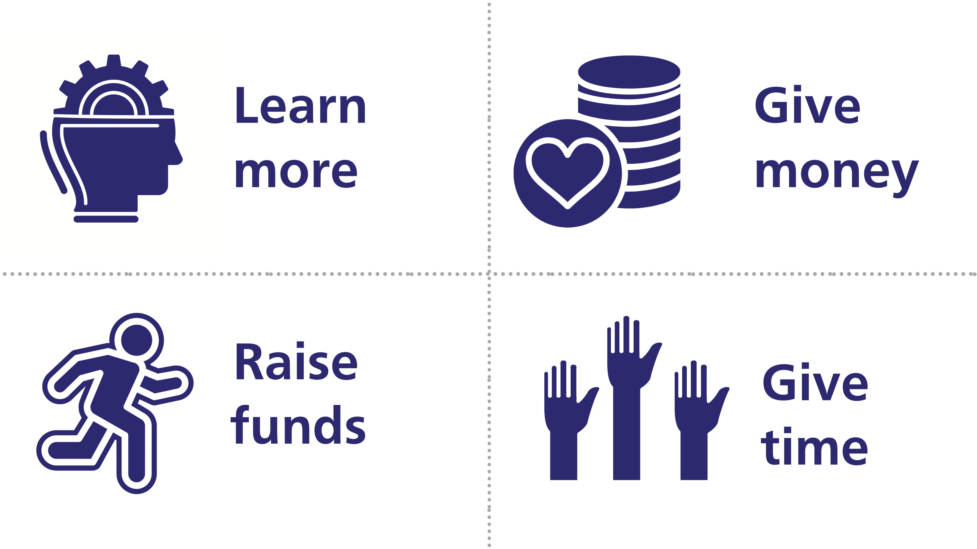
How you can help
Notes:
Learn more – visit WATSAN’s website www.watsanuganda.org and sign up to the newsletter there
Give money – WATSAN needs more regular standing orders to fund its expert local staff team, and to put towards its next big target project
Raise funds – could you do sponsored challenge for WATSAN? Or take part in their regular Walks for Water?
Give time – WATSAN is looking for new trustees to join its board, or volunteers to coordinate events

Slide 14
www.watsanuganda.org
For the latest news, events, videos and project info,
as well as how to fundraise or donate!

Slide 15
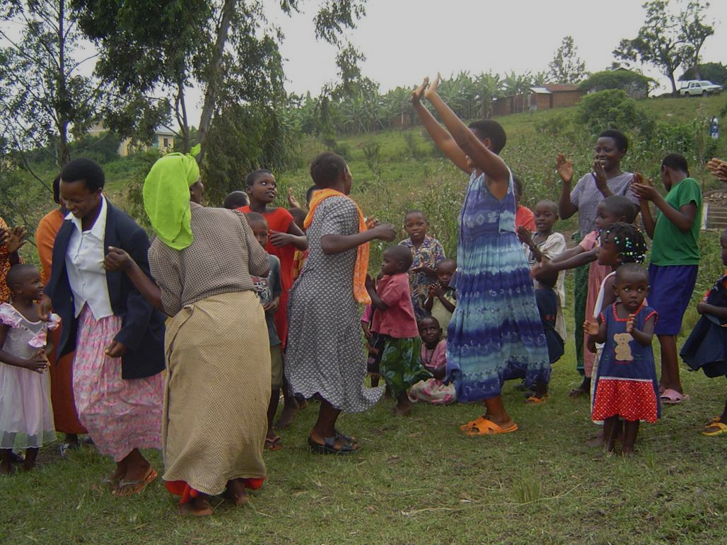
Thank you!
Notes:
Thank you for listening! Here’s how the community in Uganda celebrate.

