Slide 1
The Funding Network 2018
Bringing water and dignity to Bwambara Hill
Notes:
Good evening everyone. My name’s Kate Parrinder and I am here tonight to tell you about WATSAN – a project in South-West Uganda that transforms lives by bringing safe water, improved sanitation and hygiene education to some of the region’s poorest people.

Slide 2
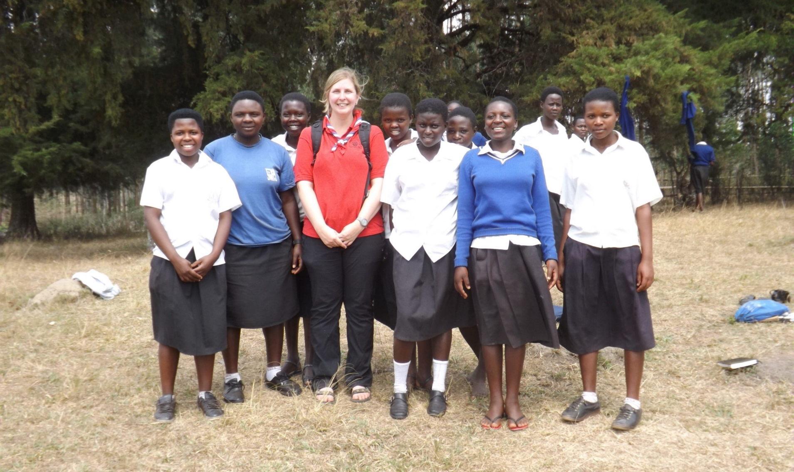
Who am I?
Notes:
My personal motivation for being involved with WATSAN is a trip I did to Uganda as leader-in-charge of a group of Girl Guides in 2013. We fundraised for and then helped to build a rainwater collection tank and protected spring in Nyabiteete School.

Slide 3
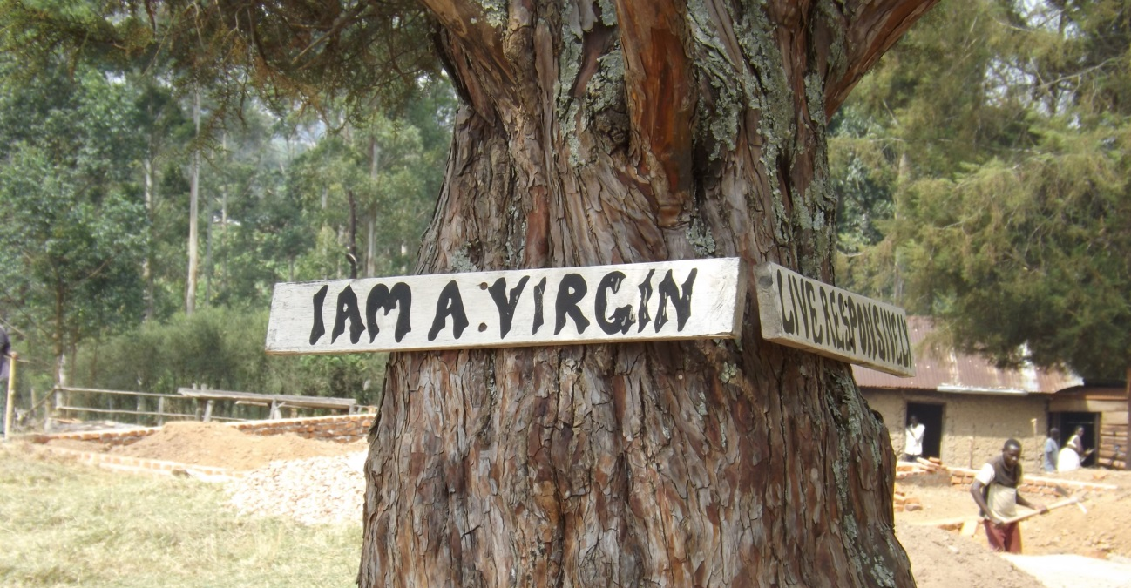
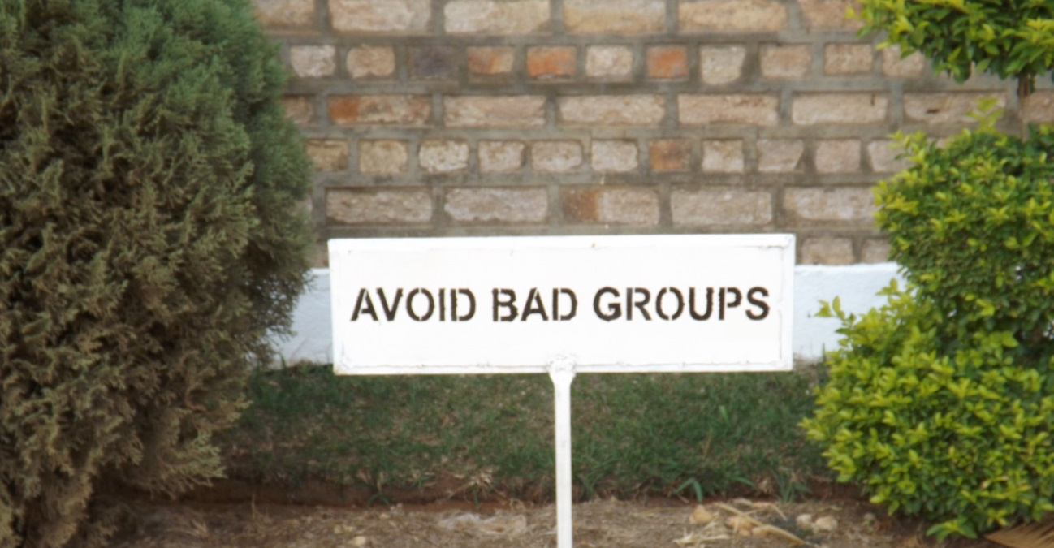
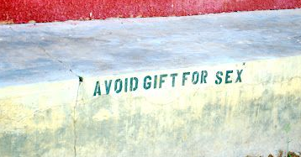
Notes:
When we were in Uganda we saw signs like these at every school, and it really made an impression on me. This is what girls like my Guides have to deal with on a day to day basis. I was struck by testimonials from community leaders that girls would be raped when collecting water in twilight hours.
So I saw some of the problems for myself, but I also experienced the nitty gritty of the great work WATSAN is doing on the ground. Since my return I have become a trustee of WATSAN.

Slide 4
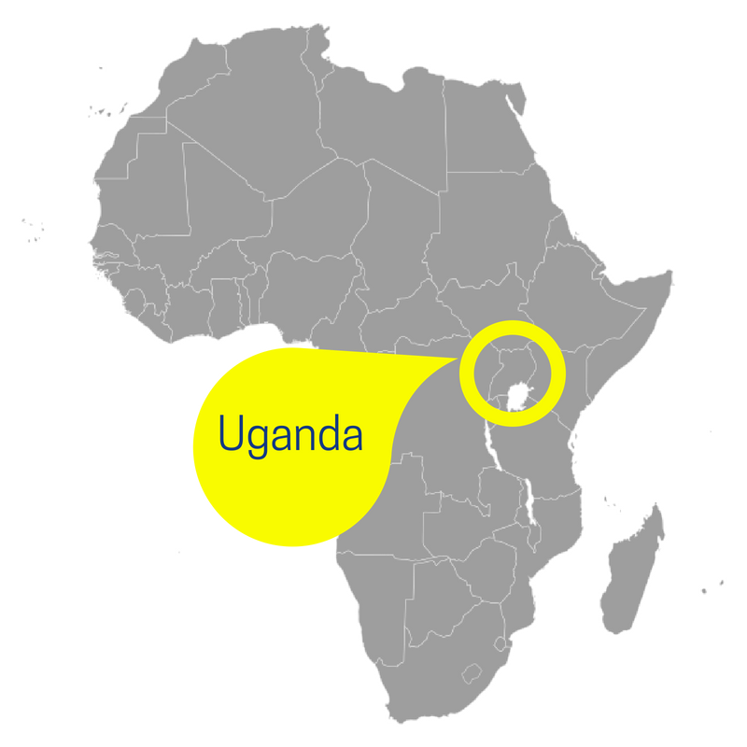
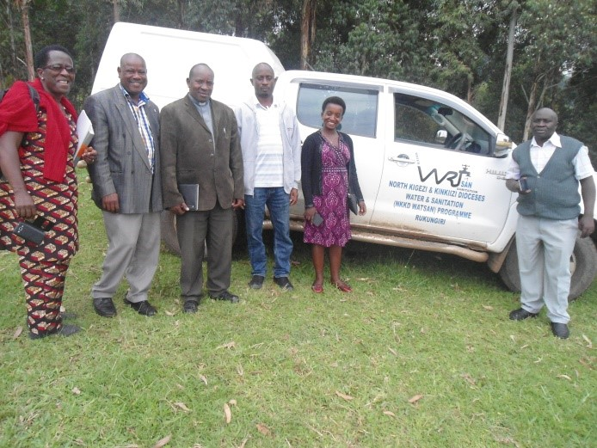
What is WATSAN?
Notes:
WATSAN consists of a small Ugandan-run staff team helping communities in Rukungiri and Kanungu Districts in the South-West of the country.
WATSAN is also the registered UK charity that supports them financially. This is run entirely by the volunteer trustee board.

Slide 5
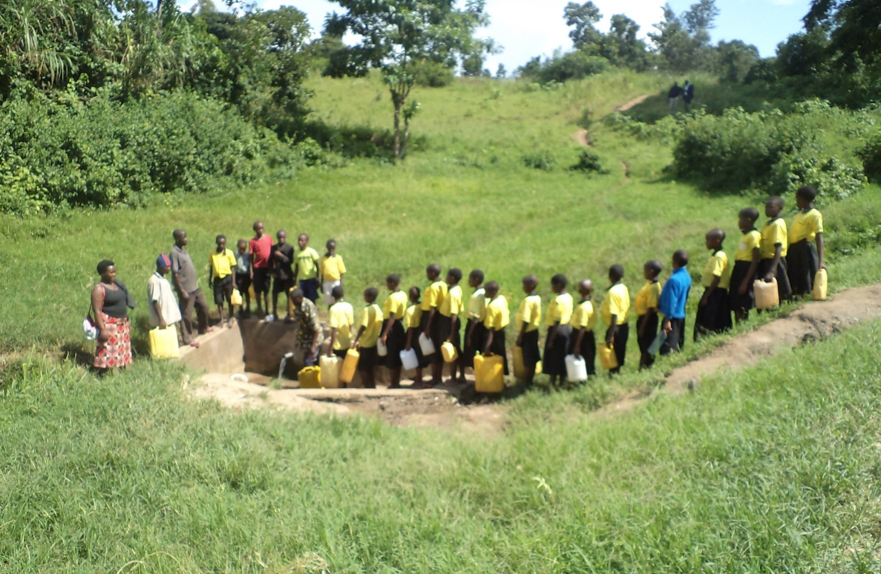
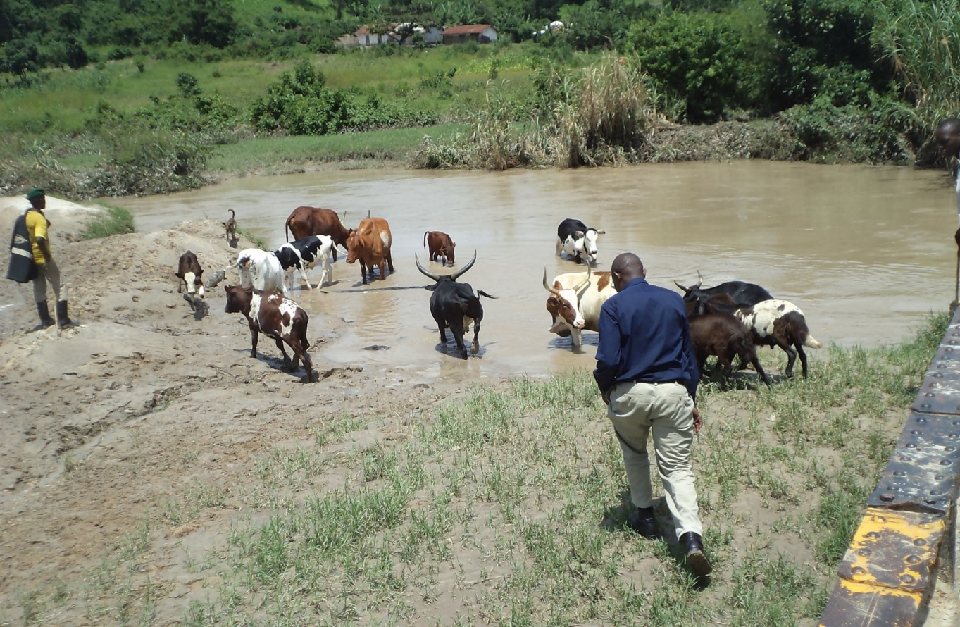
The problem
Existing spring in Bwambara, and Rushaya River
Notes:
The project I am pitching for today is Bwambara Hill, which is a community of one-thousand five hundred people in Rukungiri District, in the heart of the Rift Valley. The area has recently suffered severe drought and crop failure, and it is many, many miles from any government-provided infrastructure. The village revolves around a primary school, secondary school and a church.
There is just one protected spring near Bwambara Hill serving thousands of people from all around, so there is always a queue to fill up your jerry can.
In drought, this dries up completely so people are reliant on collecting water from the Rushaya river (pictured here), which is four kilometres’ walk away from the homes and schools, and as you can see, it’s polluted with mud and animal faeces, and more…

Slide 6
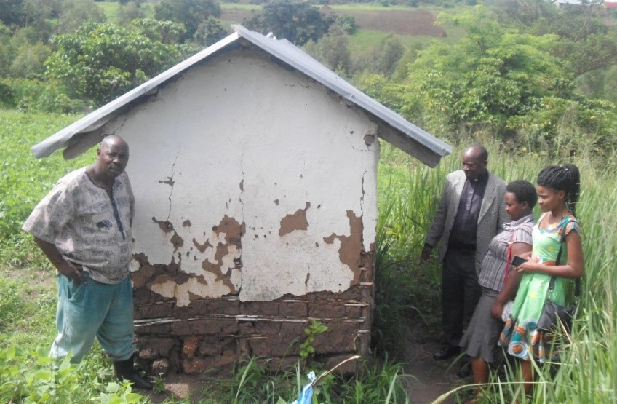
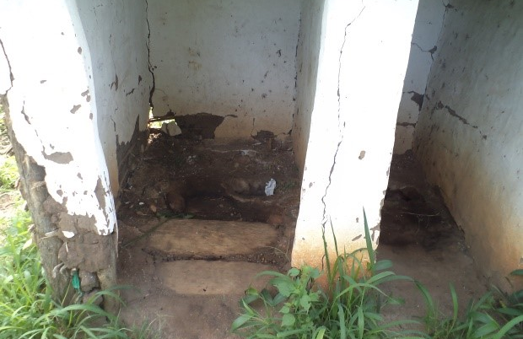
The problem
Current sanitation
Notes:
These are the main community latrines at the church in Bwambara Hill. Because they are squalid and fly-blown, people instead go in the bushes, which pollutes the area and endangers health.
The knock-on effect of all this is that people regularly get sick. Children miss on average 25% of their education whilst suffering from water-borne illnesses, and also because they are collecting water for their families. For the girls it’s even worse – they miss school whilst they are menstruating, as there are no facilities at school.
This in turn means that there is a lack of social mobility, with poverty becoming embedded and reproducing itself again and again across generations.

Slide 7
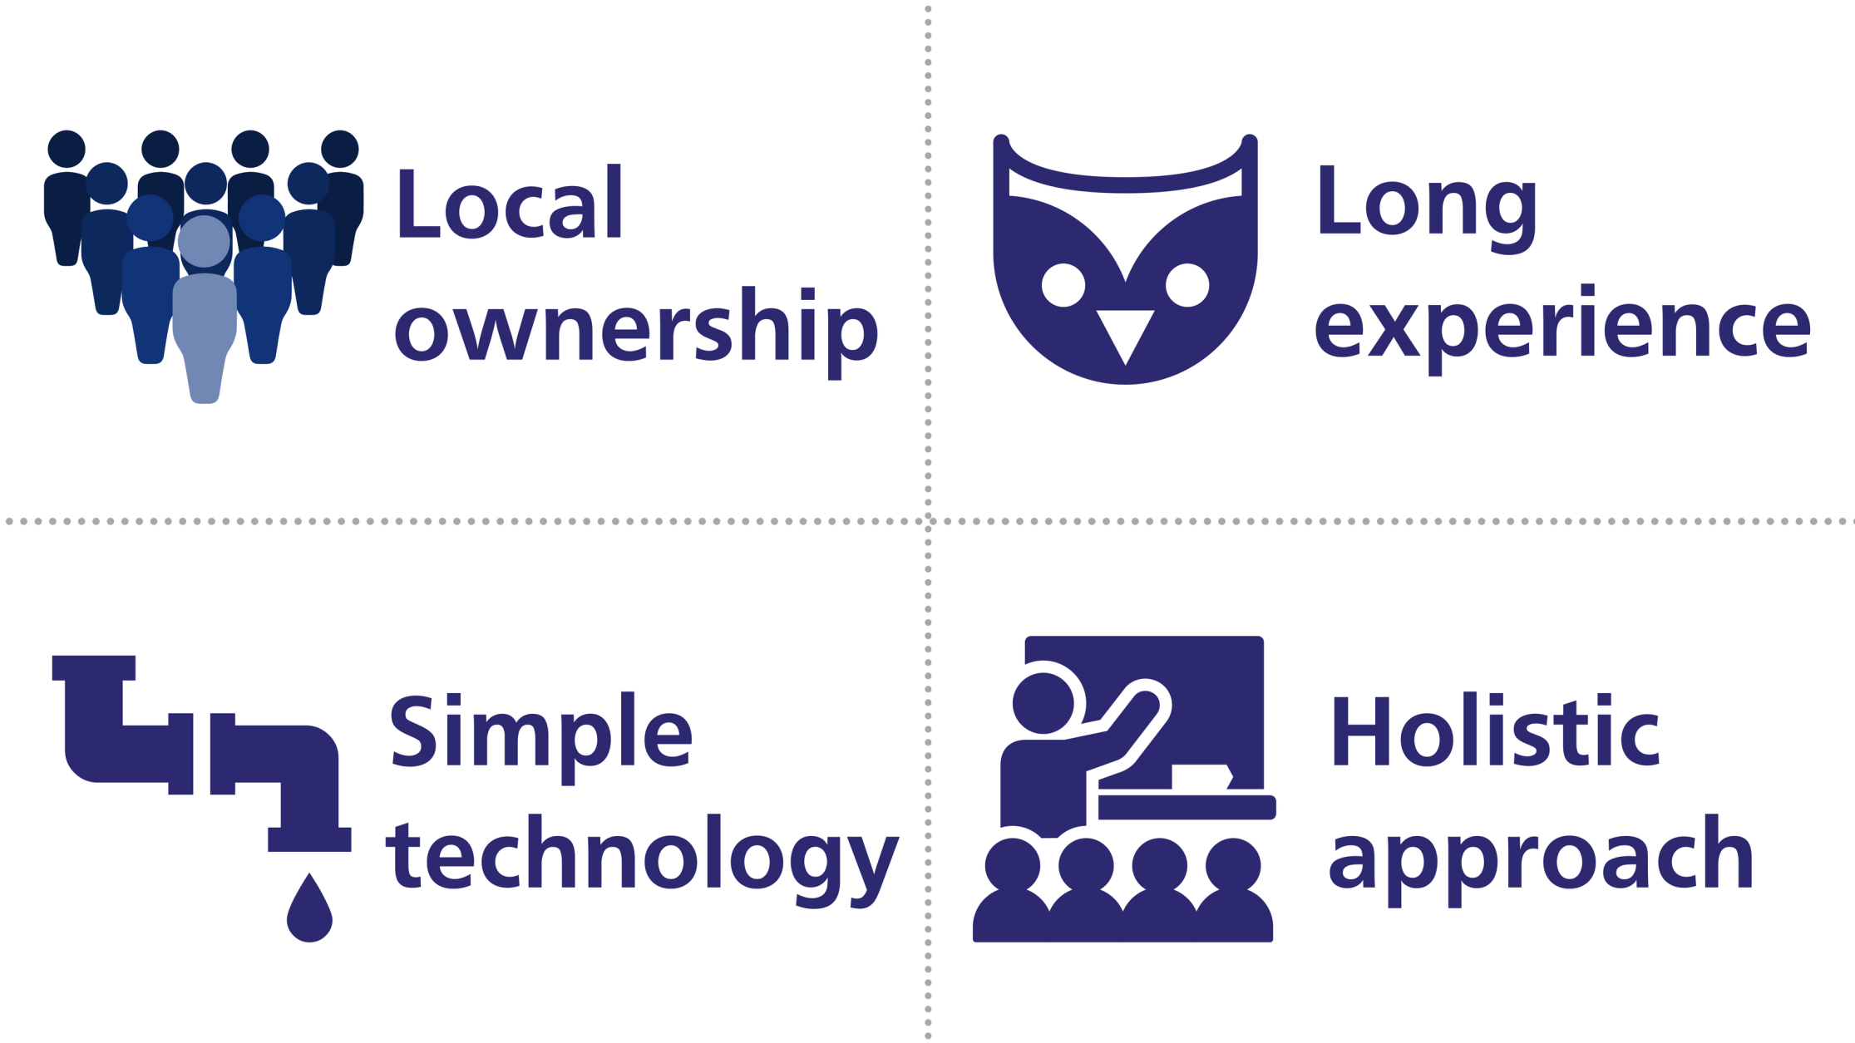
Our solution
Notes:
The WATSAN team has completed a baseline survey at Bwambara Hill so that they can benchmark progress against the current situation. Like every WATSAN project, the solution has these four elements:
It is owned by the local community – we get their buy-in to the build right from the start, and formally hand the project over to them at the end.
WATSAN’s experienced staff have been operating in the area since the 1980s, and have built the trust of local community leaders.
The structures we build are simple – Africa is littered with complex, broken down projects created by well meaning westerners; ours are largely static and made of bricks and cement, using local aggregates collected by the communities where possible!
Our approach is holistic in that we don’t just build water and sanitation facilities (known as hardware) – every project also has a community engagement and hygiene education component (known as software).

Slide 8
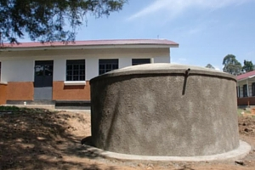
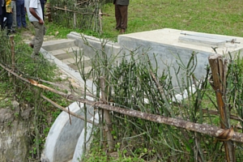
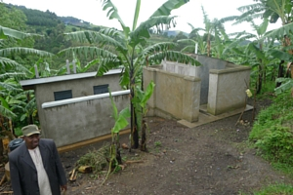
Hardware
Rainwater harvesting tanks
Protected
springs
Latrines
Notes:
These are some examples of the typical ‘hardware’ WATSAN builds to collect water and provide safe facilities.

Slide 9
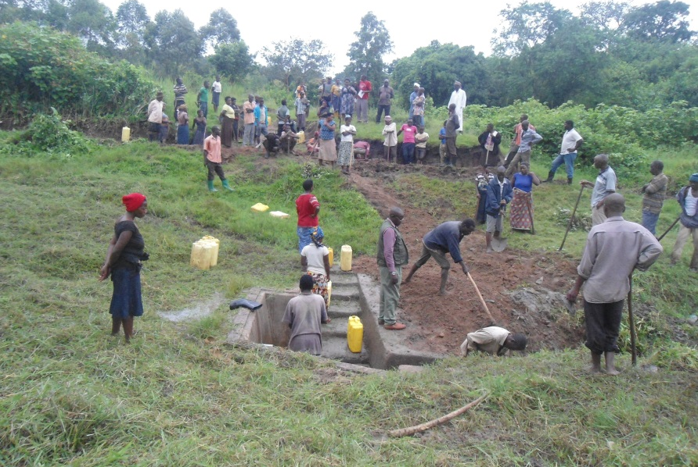
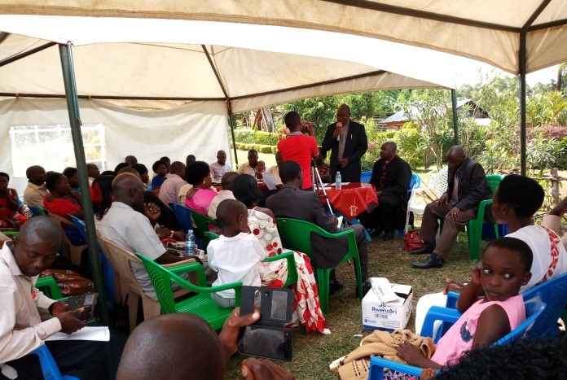
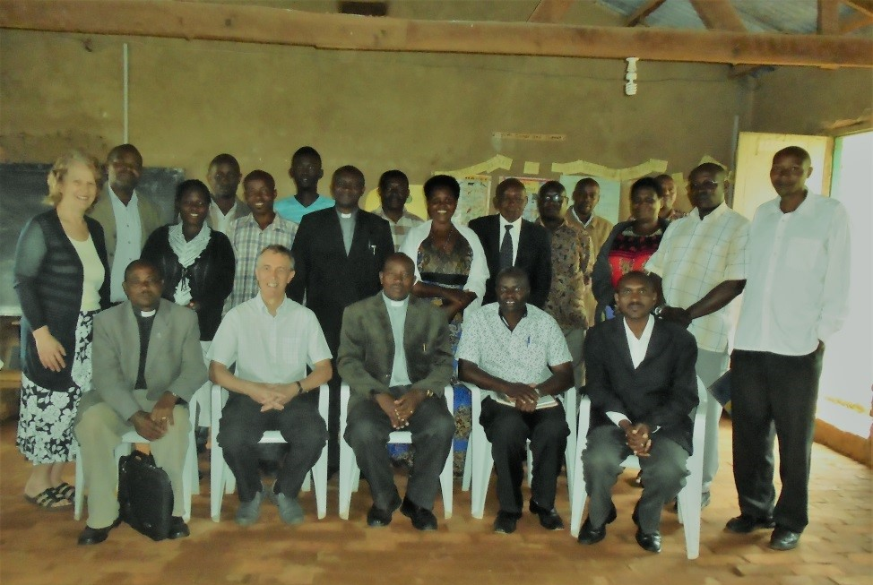
Software
Mobilisation
Sensitisation
Management
Notes:
So some examples of software… The local community is mobilised to contribute physical labour and materials towards every project, and this is actually factored in to our budgeting.
The sensitisation process involves education in hand-washing, home care and personal hygiene, which is actually just as effective as the improved facilities in reducing disease.
The completed facilities are handed over to an officially formed ‘Organisation and Management Committee’. Committee members are given comprehensive training in everything from maintenance to record keeping.

Slide 10
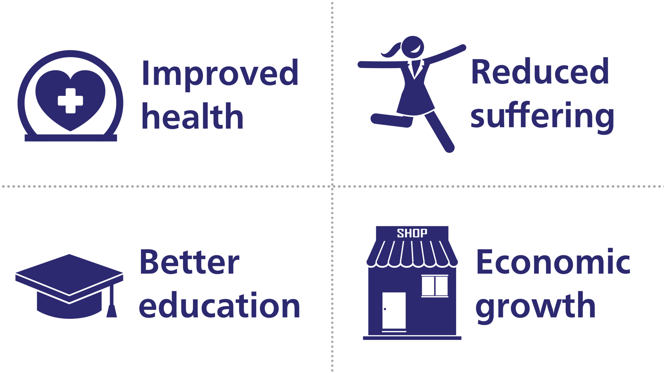
Impact
Notes:
In areas where WATSAN has implemented water and sanitation systems we have seen some really brilliant results:
People have better health – clinics report fewer cases of diarrhoeal disease, and we can test the water to show that there’s far less contamination by harmful bacteria
People simply suffer less – children are safer from abuse as they can be more closely supervised, and live better and longer lives
Better education is one of the most immediate and measurable impacts – school enrolments go up, better teachers are attracted to the school, and exam results improve, usually within a year of the project
This all means that communities can become more productive – we have seen that where water and sanitation are provided, women in particular have the time to maintain smallholdings or sell crafts; new facilities often spring up in the area, such as medical centres

Slide 11
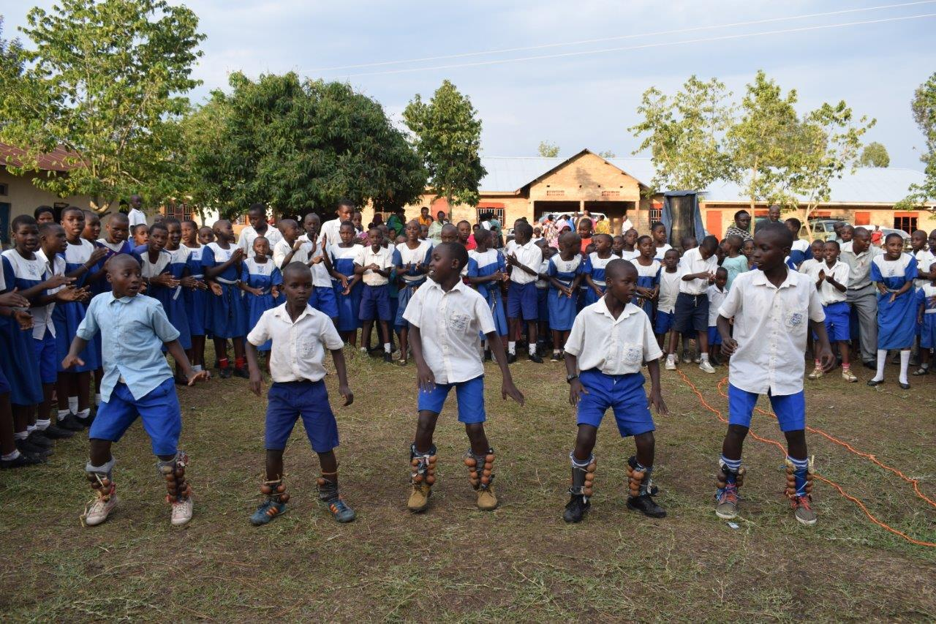
Case study
“
Our school was like a desert! Moving five kilometres to get a jerrycan of water, without toilets or bathrooms, living a miserable life! WATSAN! WATSAN! WATSAN! What a wonderful work you have done.
”
Part of a poem recited by the Head Girl at the commissioning ceremony at Burema Senior Secondary School
Notes:
It’s important not to forget one key outcome: water gives life, but sanitation gives DIGNITY. This is a key principal of WATSAN’s work.

Slide 12
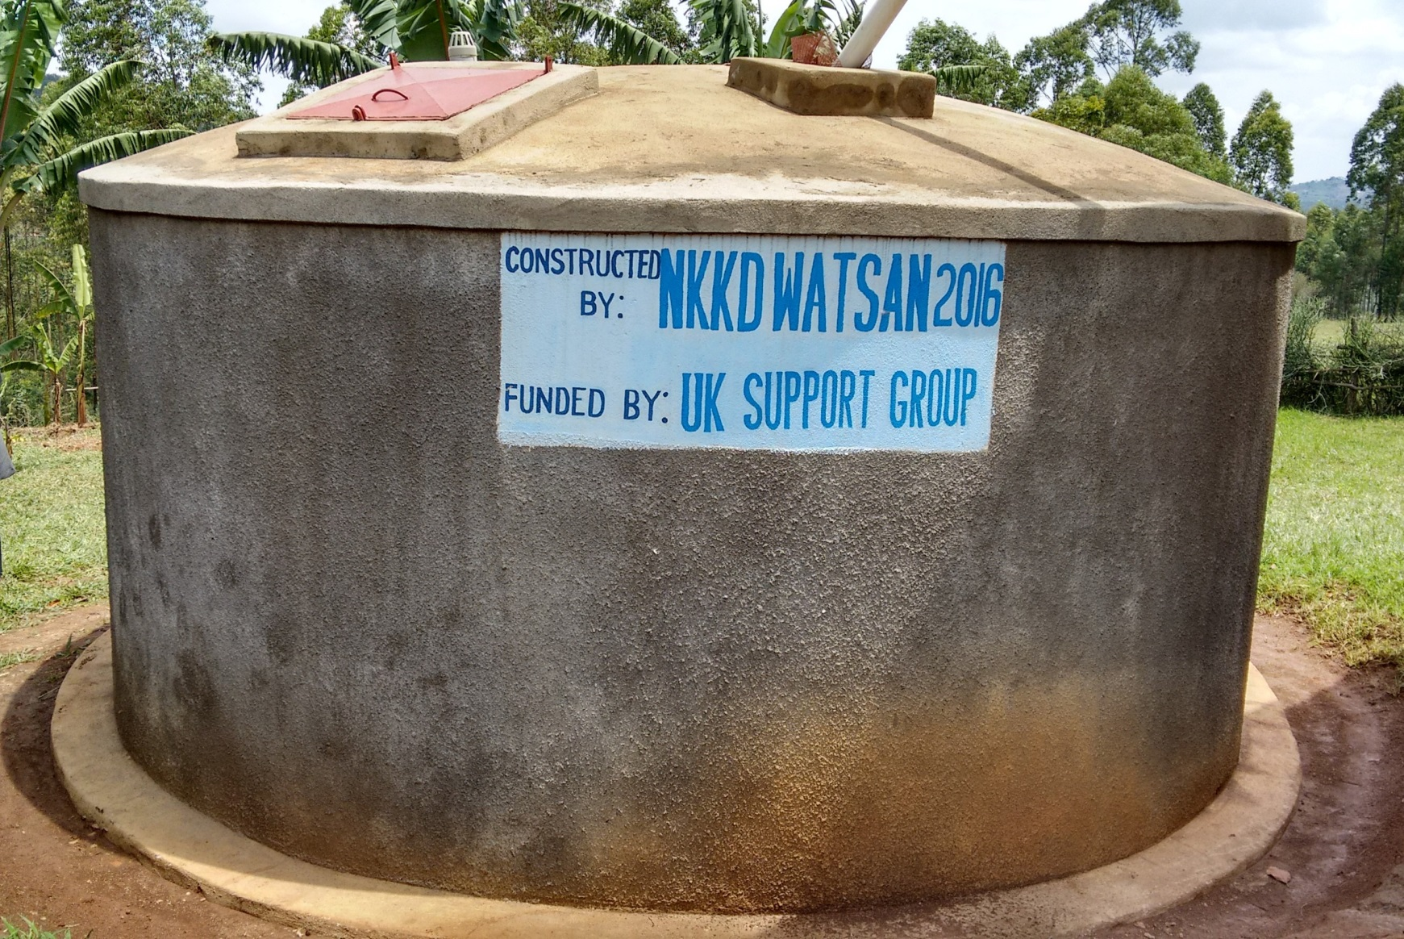
How you can help
£3,000…
Notes:
So in Bwambara WATSAN plans to build three rainwater harvesting tanks, of 30 cubic metres each – one for each of the two schools, and one for the church.
Funding for the first two has actually already been raised by WATSAN, and sent to out the field last month – and if we raise £3,000 tonight we can build the final one!

Slide 13
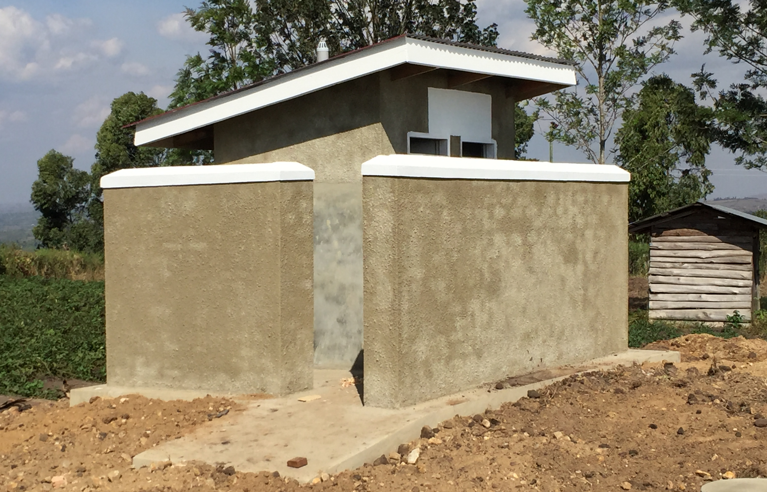
How you can help
£1,500…
Notes:
A further £1,500 raised tonight would enable us to build a pit latrine like this one for one of the schools, giving teaching staff the same facilities as the pupils, which are also being built as part of this project.
All of these costings are inclusive of the associated ‘software’ activities required to bring about sustainable change.
There are some non-financial ways you can help – perhaps you can ask me about these in the Q&A?!
NB total project cost is £38k, or £25 per head

Slide 14
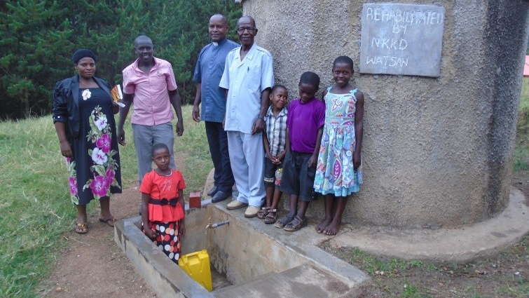
Thank you.
Notes:
Thank you for listening!

Slide 15
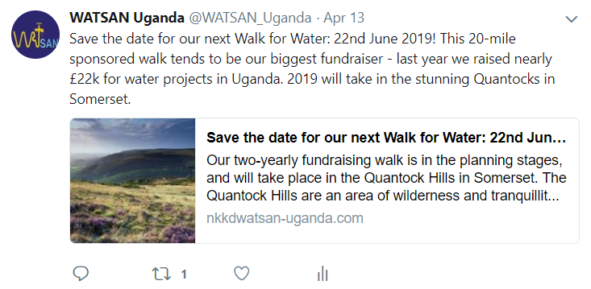
Other support…
Notes:
Here are some ways beyond the financial that you can support WATSAN…
Follow us on Twitter or sign up to our newsletter on our website, nkkdwatsan-uganda.com
Can anyone help us with social media publicity?
Feel free to join our Walk for Water in June 2019!

